Slide 2


Project Proposal
Notes:
It’s quite interesting how a single cell turns into a complex multicellular individual like a human being.
Each tissue of this individual has cells with different morphologies and functions.

Slide 3
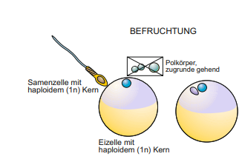
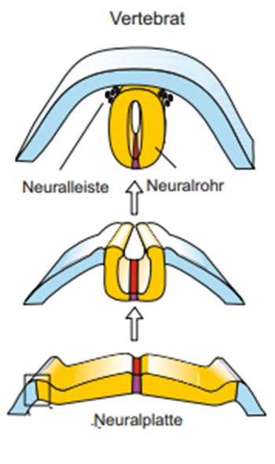

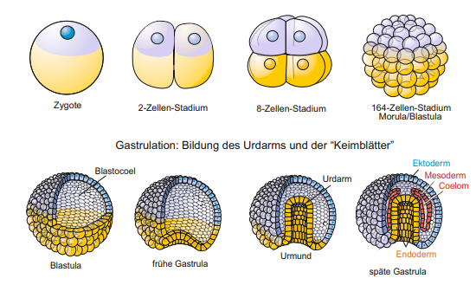


1. Embryogenesis
Fertilization
Neurolation
rapid cell devision
Gastrulation
Entwicklungs-und Reproduktionsbiologie, Müller 2018
Notes:
And those tissues develop during Embrygenesis. Frist of all we have to classify the initial stages.
The whole process starts with the fertilization of an egg by sperm.
As a result, the fertilized egg gets into a process of rapid cell devisions, which led to the creation of the Blastula.
The three germ layers ectoderm, mesoderm and endoderm are created during Gastrulation.
Neurodermal tissues from the ectoderm differentiate to the neuronal plate. The neuronal plate closes and creates the neuronal tube.

Slide 4
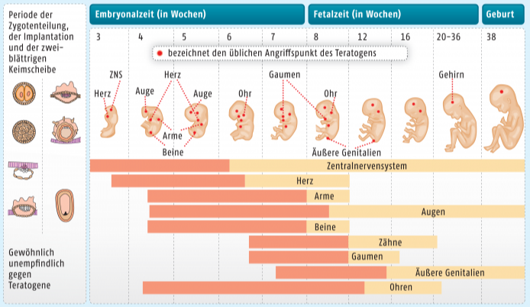
1. Embryogenesis
Our dataset targets week 4 to 9 of embryonic development
Organogenesis
https://www.deutsche-apotheker-zeitung.de/daz-az/2016/daz-20-2016/abraten-oder-zustimmen
Notes:
Finally the organs are created during organogenesis
Our dataset targets week 4 to 9. Especially the brain develops
At week 4: the neural tube closes and the heart starts to beat and first structures like arm buds develop.
The brain of the fetus grows during the next weeks and the Prosencephalon develops to the Diencephalon and Telencephalon. Furthermore the morphology of the embryo changes.
Major parts of the brain are developed at week 9.
Many signals influence the development of the brain e.g. chemokines.

Slide 5
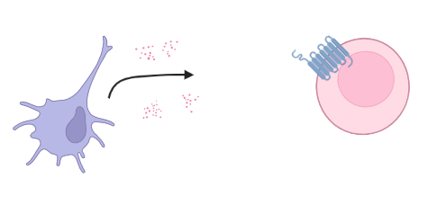
2. Chemokines
Groupe of small similar proteins
chemoattractors
Bind to G-Protein coupled receptors (GPCR) → induce signaling cascade
Notes:
But what are chemokines ?
Small groupe of proteins with similar structure.
Chemoattractors: -> cells (dendritic cells) rerlease them, effector cells (leukocytes) move to the origin of release
->chemokines bind to GPCR and induce signaling cascade
They play an important role in embryonic development, which is unknown.

Slide 6
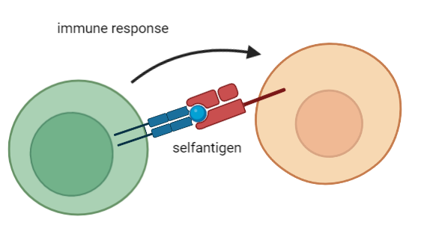
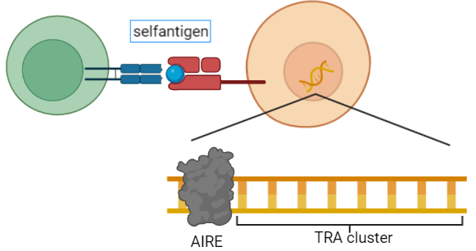
3. Tissue restricted antigens (TRAs)
Genes for Self-antigens → essential for functional immune cells
Genes which are more than 5x than the median in less than 5 tissues expressed
Ordered in Autoimmune Regulator (AIRE) controlled cluster
Notes:
Another important issue are TRAs
Functional immune cells are necasssary to prevent infections
Shouldn’t react against selfantigens -> negative control in thymus
Medullary thymic epithelial cells (mTECs) present slef-antigens on their surface, reacting immune cell will be removed
Tissue restricted antigens (TRAs) code for selfantigens
TRAs are ordered in cluster which are controlled by the transcriptionfactor Autoimmune Regulator (AIRE)
Genes more than 5x the median in less than 5 diffrent tissues expressed

Slide 7
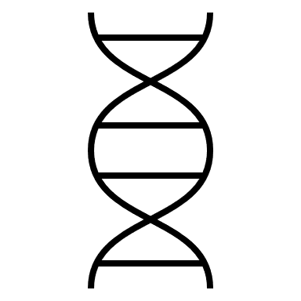

Dataset

Slide 8
Quality control
Affymetrix Human Genome U133 Plus 2.0 Array
Expression analysis of over 47,000 transcripts and variants through comparison of 54 000 probe sets
detection sensitivity 1:100,000

Slide 9
Quality control
1. Array surface images
No spatial artefacts
Slight difference in overall intensity

Slide 10
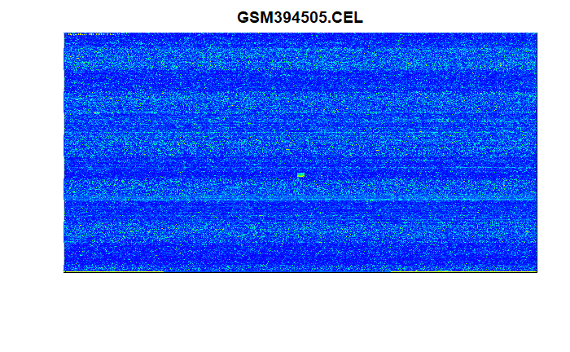
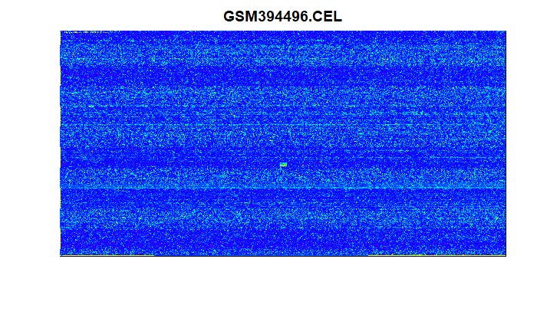
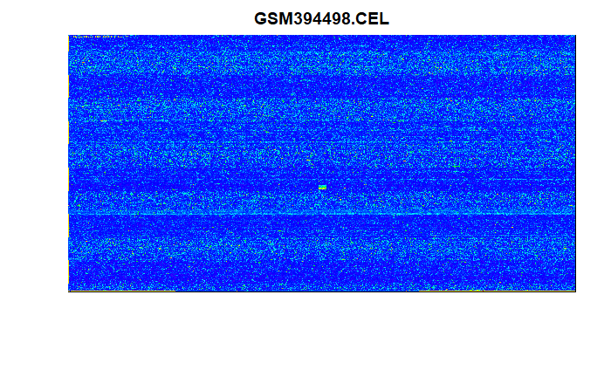
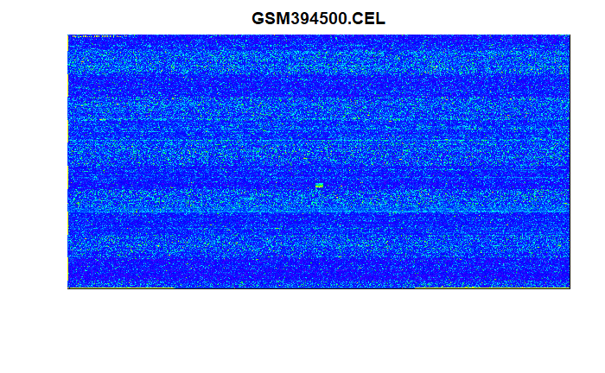
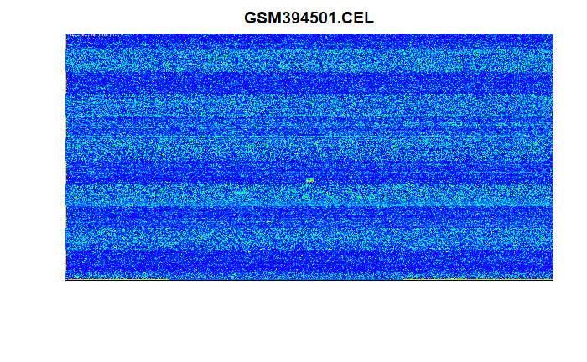



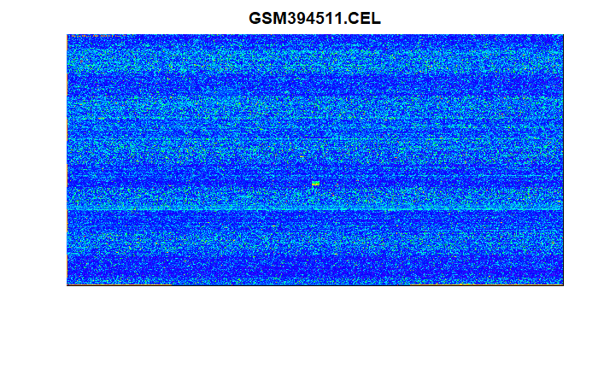
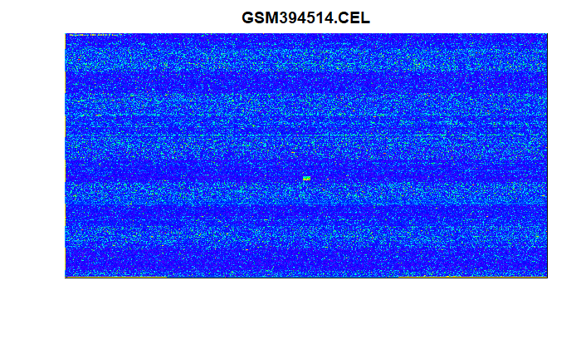
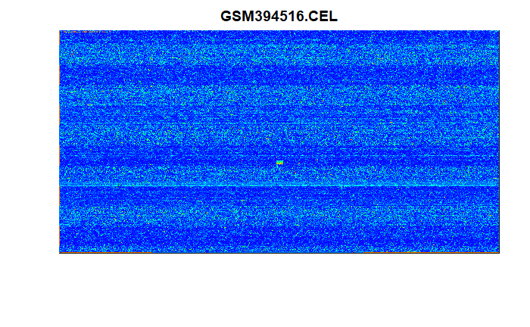
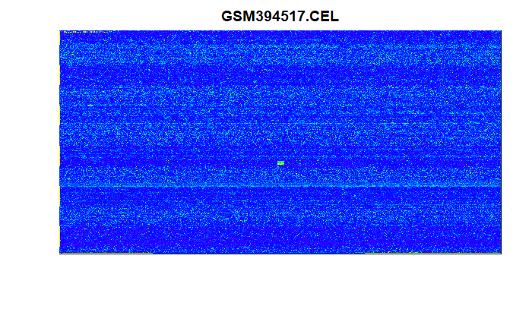
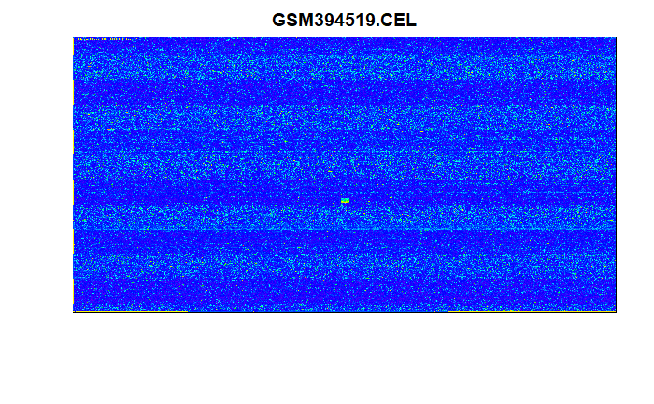

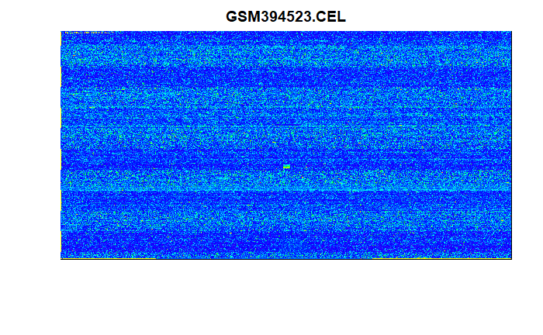
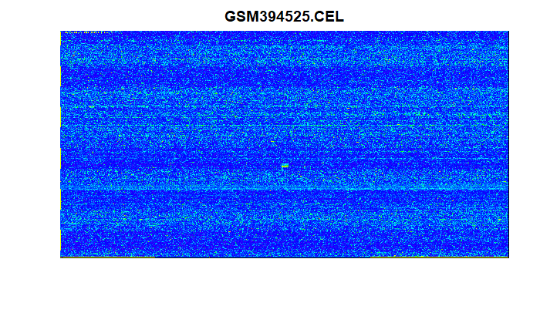


Dataset

Slide 11
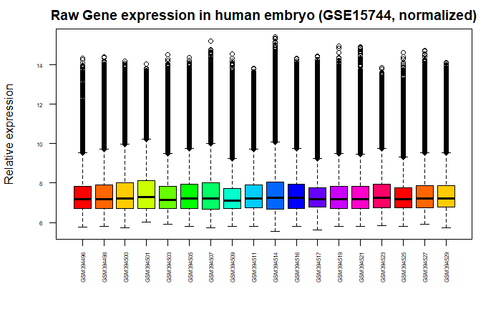
Quality control
2. Expression boxplot vsnrma normalized
All chips in similar range after normalization
All 18 chips accepted

Slide 12
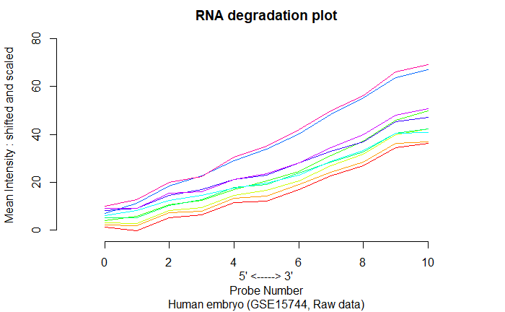
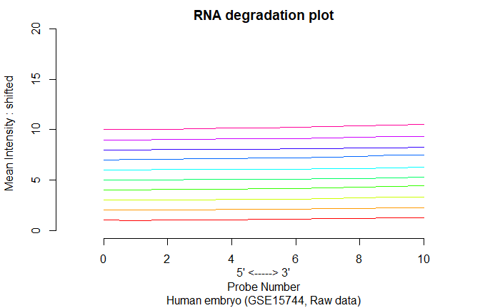
Quality control
3. RNA degradation plots
Similar distribution in RNA degradation in all chips
All 18 chips accepted

Slide 13
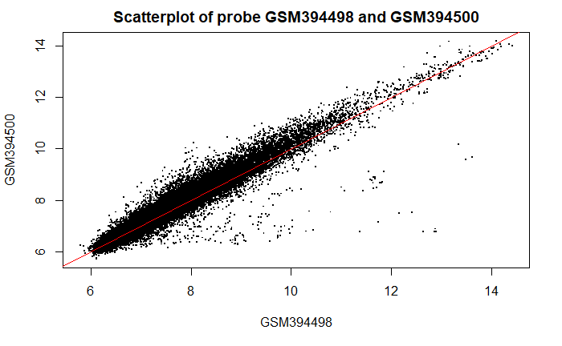
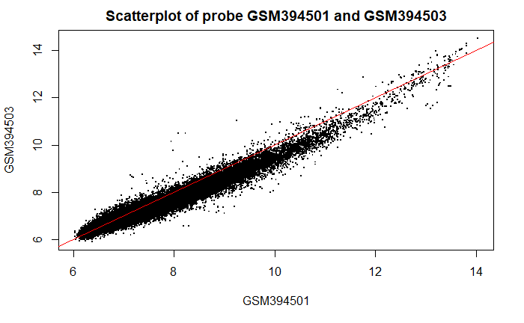
Quality control
4. Scatterplots
Similar distribution in RNA degradation in all chips
All 18 chips accepted
week 1, rep 2 and rep3
week 5, rep 1 and rep2

Slide 14
Biological background
1. Biological thesis
How do TRAs influence embryonic development ?
Do TRAs influence the development of the CNS during week 4 to 9 ?
Are chemokines or their receptors presented in this developmental stage ?
Notes:
TRAs are meant to play an important role in embryogenesis, therefor we’ll investigate: How do TRAs influence embryonic development ?
Furthermore we’ll try to figure out, if TRAs influence the development of CNS during week 4 to 9. In addition we’ll try to identify the role of chemokines for the CNS in this period.

Slide 15

Milestones/Timeline

Slide 16

Team/Roles

Slide 17
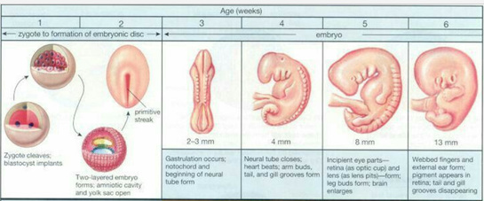
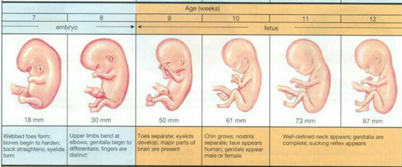
Biological background- Supplementary
1. Embryonic development
https://www.pinterest.de/supermamame/fetus-week-by-week/

Slide 18
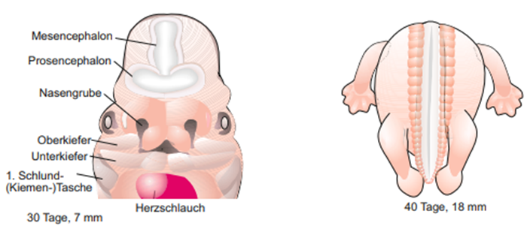
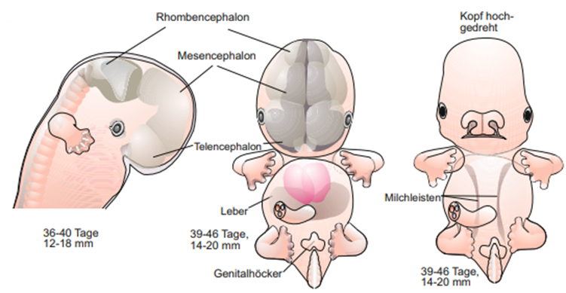
Biological background- Supplementary
1. Embryonic development
Entwicklungs-und Reproduktionsbiologie, Müller 2018

Slide 19
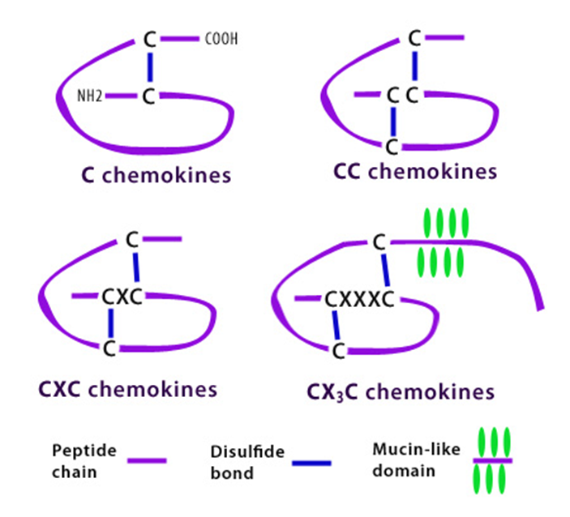
Biological background- Supplementary
2. Classes of chemokines
https://www.biolegend.com/chemokine_receptors

